Slide 1

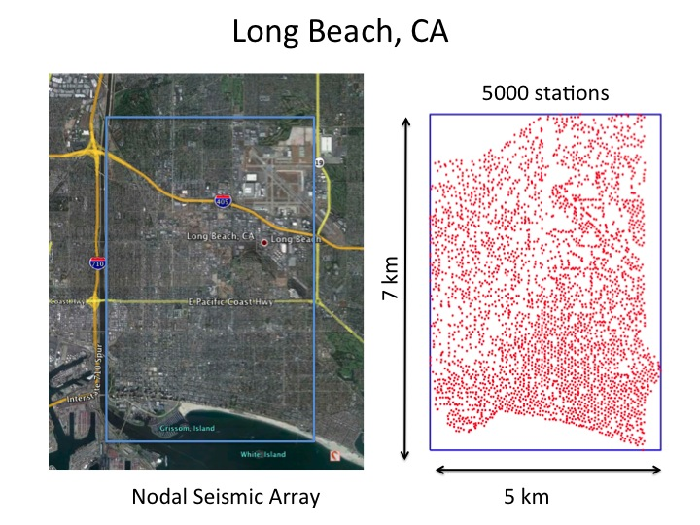
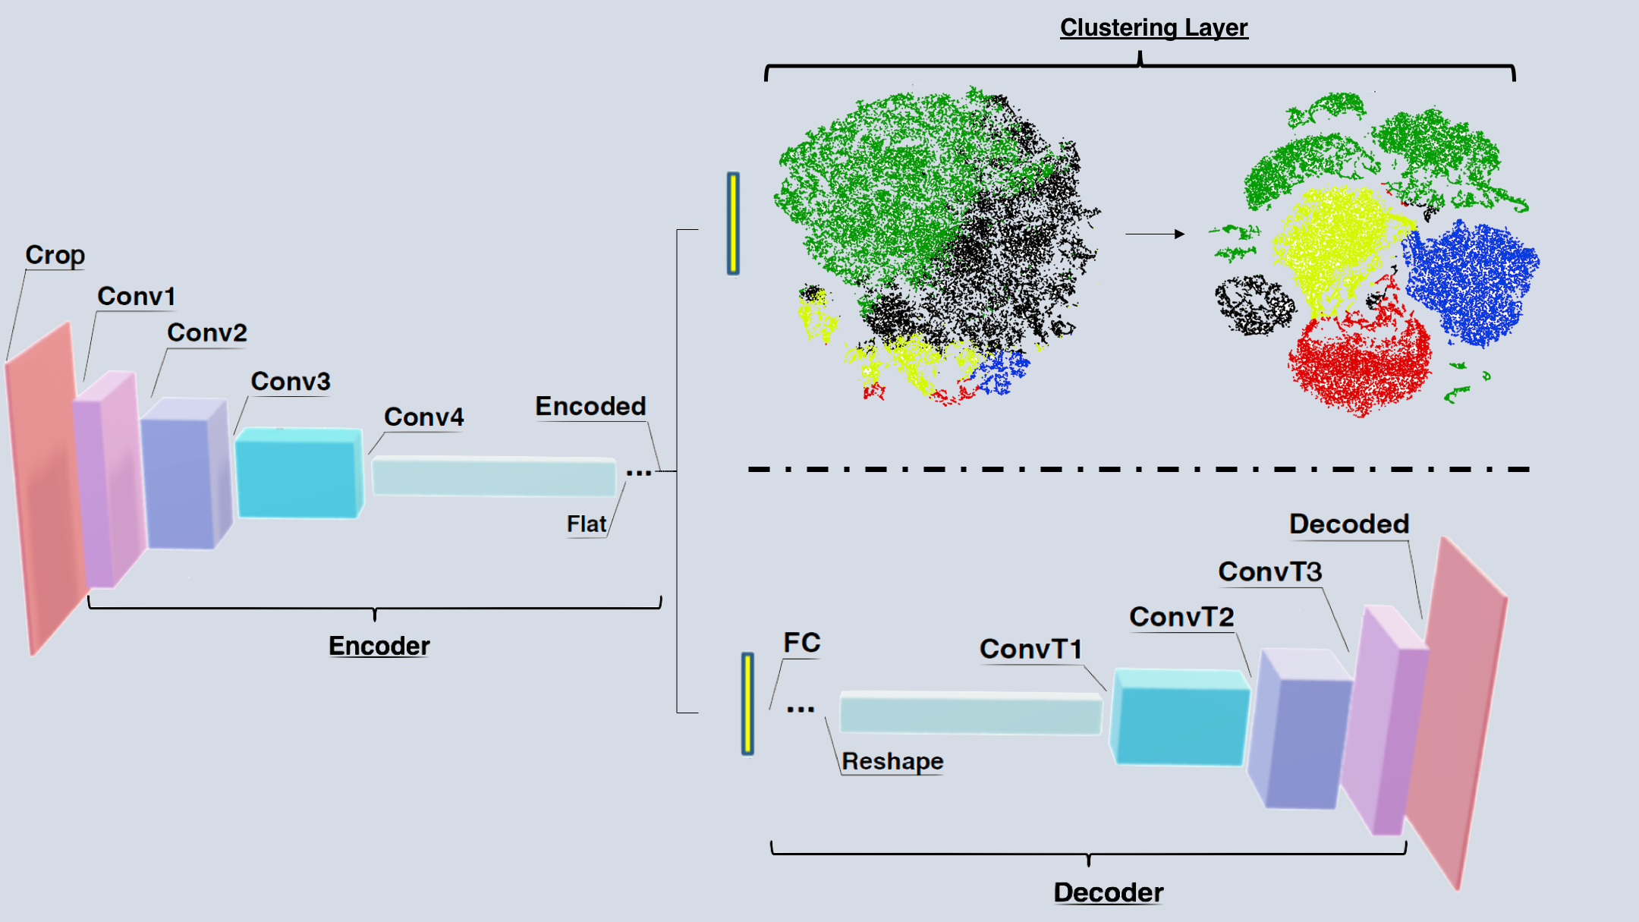
Deep Clustering to Identify Sources of Urban Seismic Noise in Long Beach, California

Slide 2
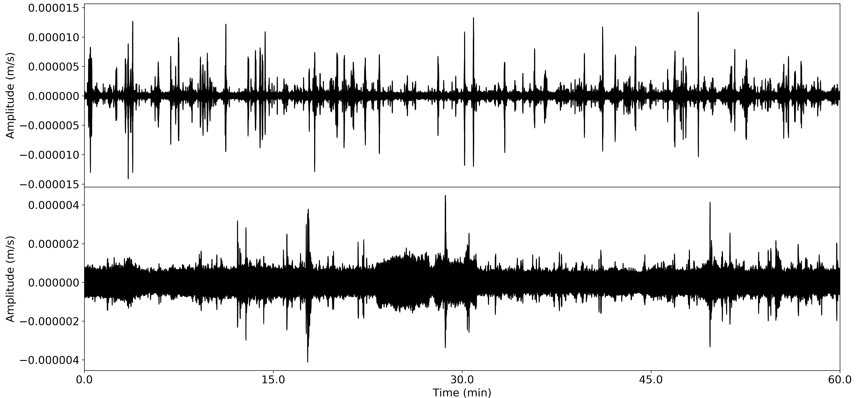
Cultural Noise:
Ground motion caused by human activity
Decreases the detection threshold for naturally occurring events
Lowers SNR
Difficult to filter
Similar frequency bands as microseismic, local, regional, events
Ongoing topic of research
Identify and characterize noise --> Remove
Very Noisy Data
Notes:
Cultural Nosie:
Any ground motion recorded on a geophone that is related to human activity
Cultural noise is an issue, specifically in urban environments with lots of human activity (I understand the irony of giving this presentation when cultural noise has never been lower)
Cultural lnoise loowere the signal to noise ratio and lowers the detection threshold for naturally occurring microseismic, local and region seismic events.
Cultural noise is problematic because its difficult to filter.
Much of the noise occupies the same frequency bands of naturally occurring signals
Ongoing topic of research, specifically how to identify and characterize the nosie so it may be removed from the records.

Slide 3
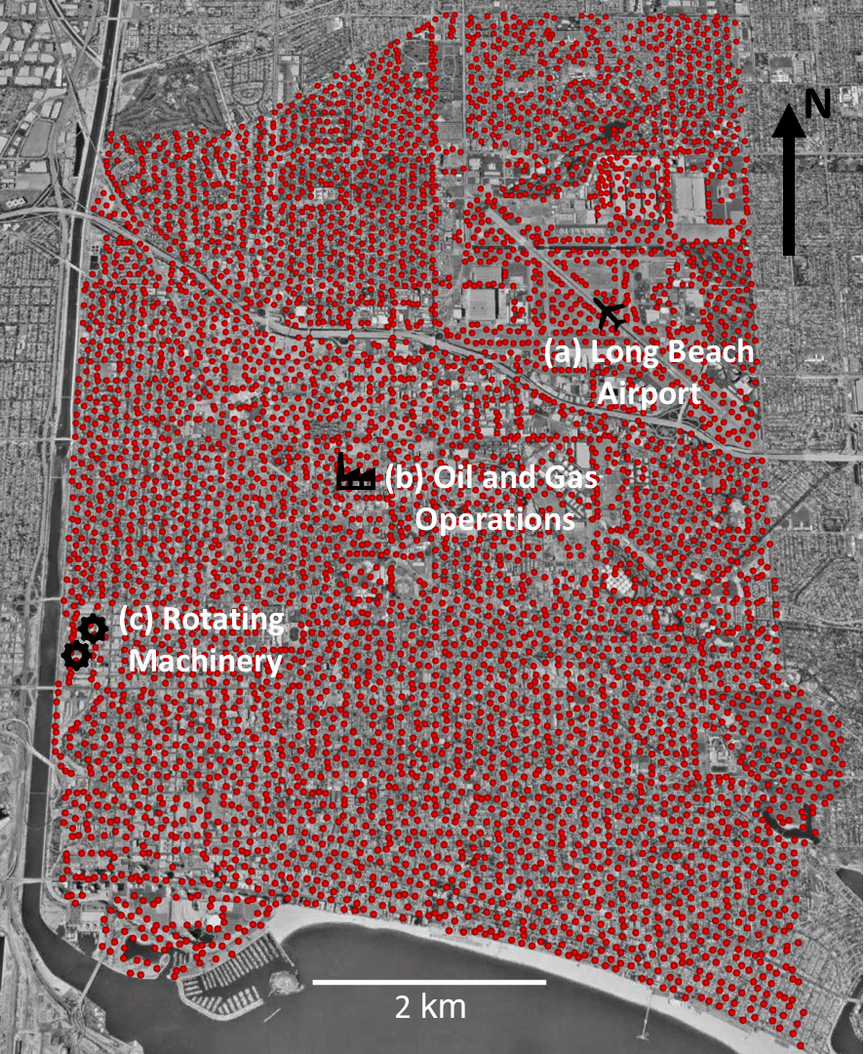
Study Area: Long Beach, CA
LB Array:
Jan-June 2011
~5200 Geophones
Velocity sensor
250 Hz sampling rate
7x10km grid
Cultural noise
Long Beach Airport
Oil & Gas Operations
Industrial Machinery
Vibroseismic Survey
Highway
No existing class labels!
Notes:
STUDY AREA:
Our project focuses on the Long Beach array.
Deployed for 6 months in 2011
Constist of 5200 geophones
7x10 km grid
All gephones are vertical ccomonent ground velocity sensors
Sampleing rate of 500 sps – resampled to 250sps
LONG beach AREA:
Residential and iduststrial area
½ million resident
Area of deployment contains major highway, airport, industrial operations and manufacturing plant
Also contains an actively producing oil field
Oil and Gas operations were the reason the array was deployed.
Part of an active source seismic survey that used vibrator trucks to generate signals that would allow for the subsurface to be imaged. Well talk about that more later

Slide 4
Goal:
Generate an unsupervised machine learning model to differentiate cultural noise signals into separable classes that reflect the noise sources where the signal was generated.
Utilize spectrograms as model input to separate and classify noise based on time-frequency domain features
Notes:
GOAL:
With all these different sources of cultural noise
We aimed to generate machine learning model that would differentiate these types of noise singals into seperable classed
These classes represent the types of signals present in the data which we hoped to correlate with the phsycial source that generated them
Since no exiting labels exist for types of cultural noise we need to use UNSUPERVISED machine learning
WE chose to work in the time-frequency domain using spectrograms as model inputs
Classify noise based on spectral amplitude features in spectrograms.

Slide 5
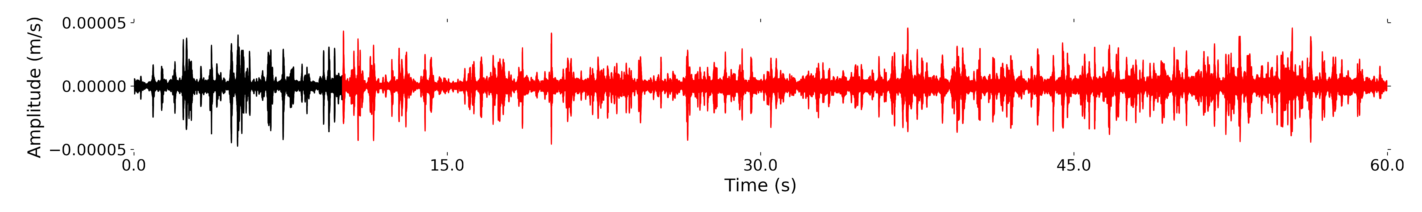
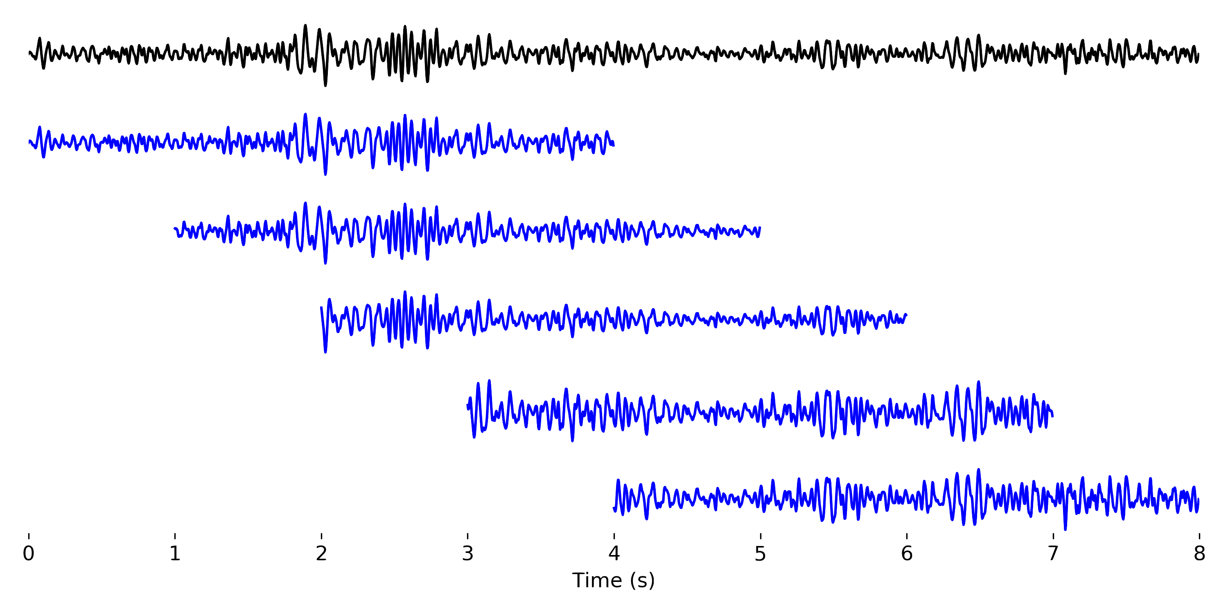
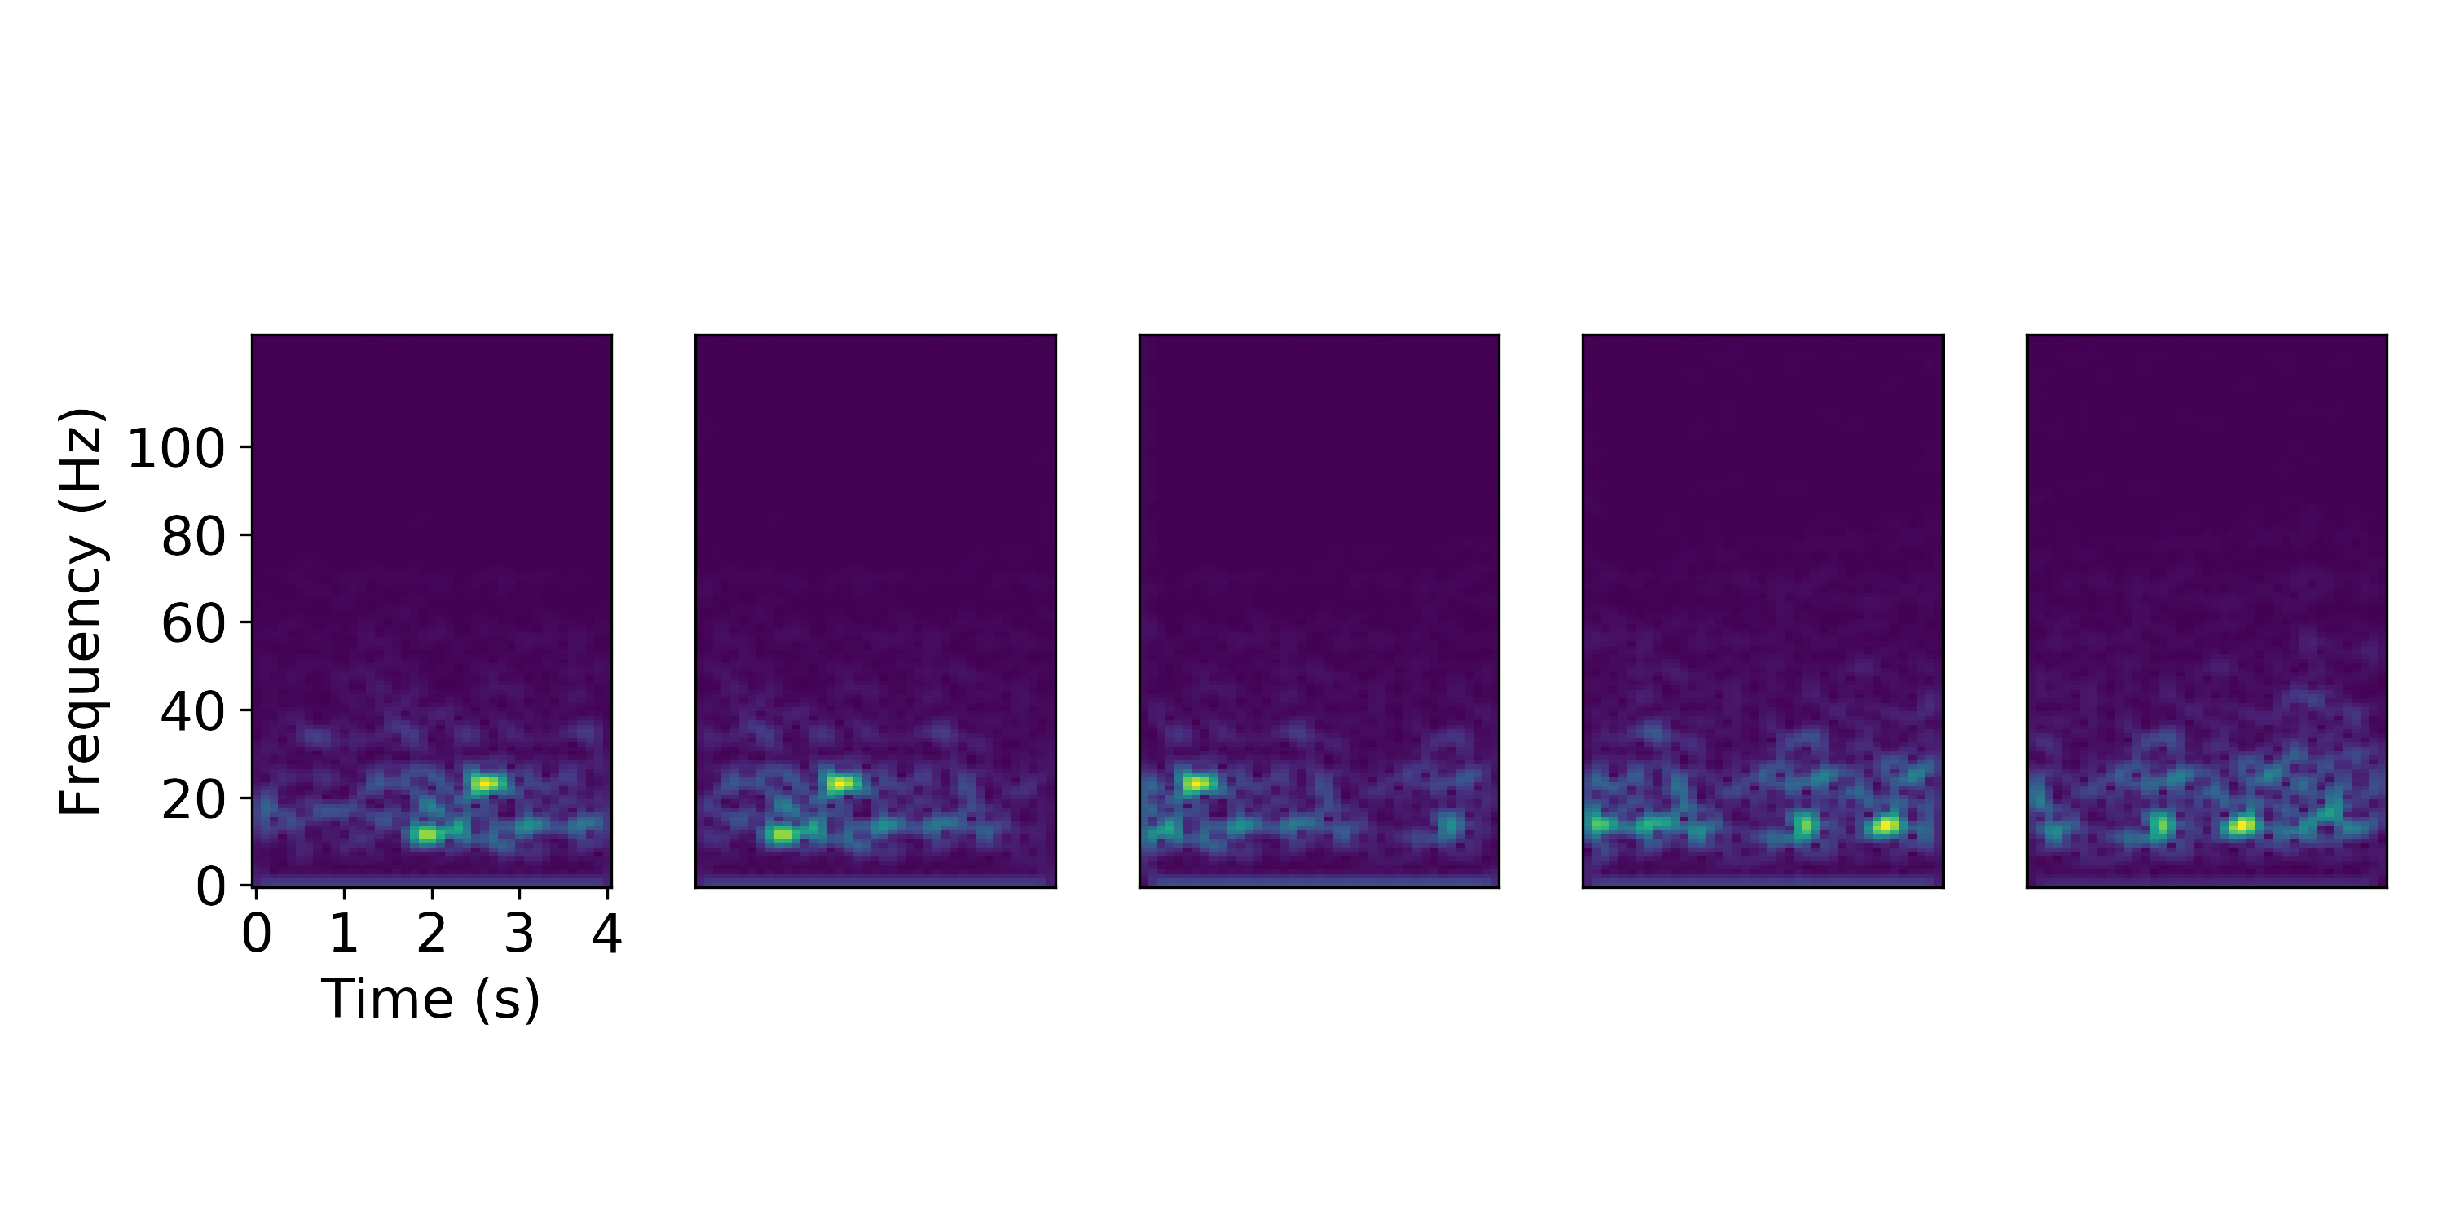
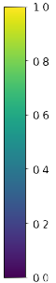
Seismic Data
Dataset Generation:
Randomly select station, day, and daytime hours.
Extract first 10 minutes from each hour selected
increase spatial coverage & signal diversity
Window into 4 s waveforms
3 s overlap
597 waveforms per station
Normalize amplitude to ±1
S.T.F.T
Hanning window: length= 125 samples, overlap = 90%
Repeat until data ⋍2,000,000 samples
Notes:
Data:
Need dataset of spectrograms to train the machine learning model
Data is given in hour-long records from 6.5 days of data for each station in array
To generate training dataset
Pull record from random day, hr, stn
Only use the first ten minutes from each record
Increases signal civersity and spatial coverage of training data
Window the 10 minutes into 4 second wf with 3 s overlap
Normalize each between +_ 1
Stft- hanning – overlap
The resulting spectrograms have 5,166 spectral amplitude features 126 freq bins 41 time bins
Frequency 1 – 126 an 4 seconds
Repeat until training dataset has 2m samples
We also generate a test dataset
Rather than randomly slecting days hors and stns
Use every station from a specific time period
Here that time period is first ten min of hour starting at 11UTC on march 6th 2011 \
Chosen because there was a vibroseismic truck actively generating signals
Signals are LFM singal that increases in frequency between 10-80hz over a 40 seconds interval
Signal generated every 1 min during this time

Slide 6
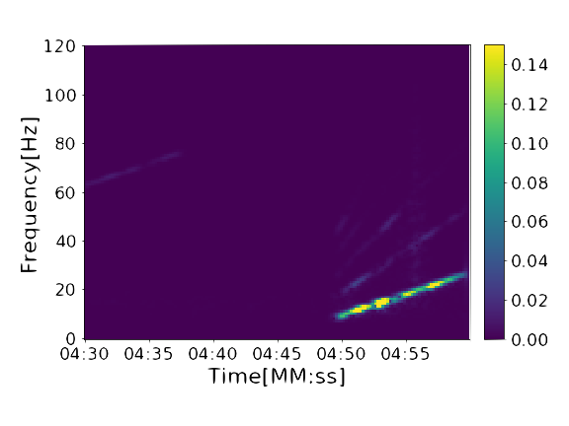
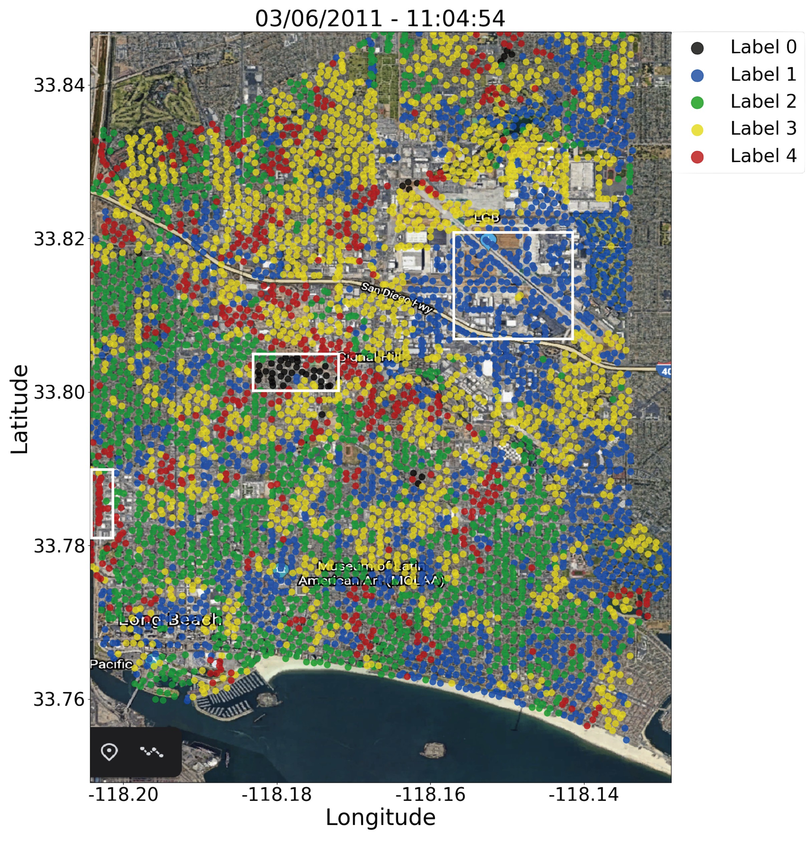
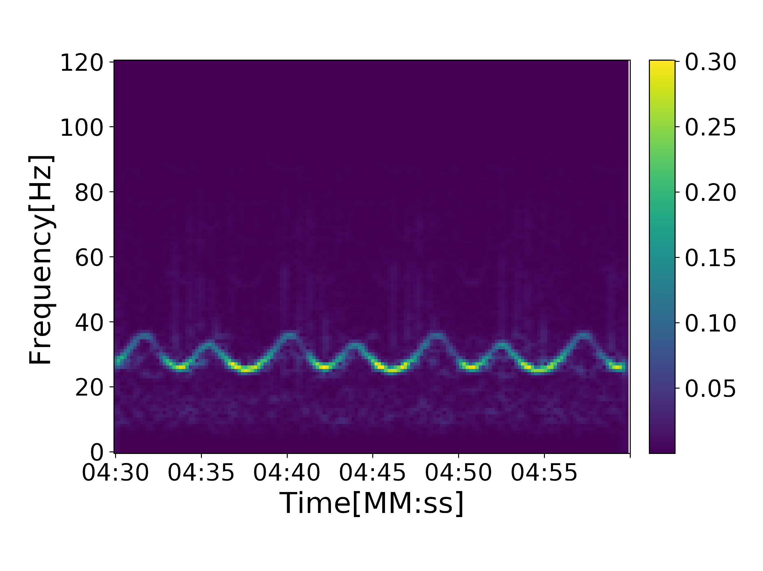
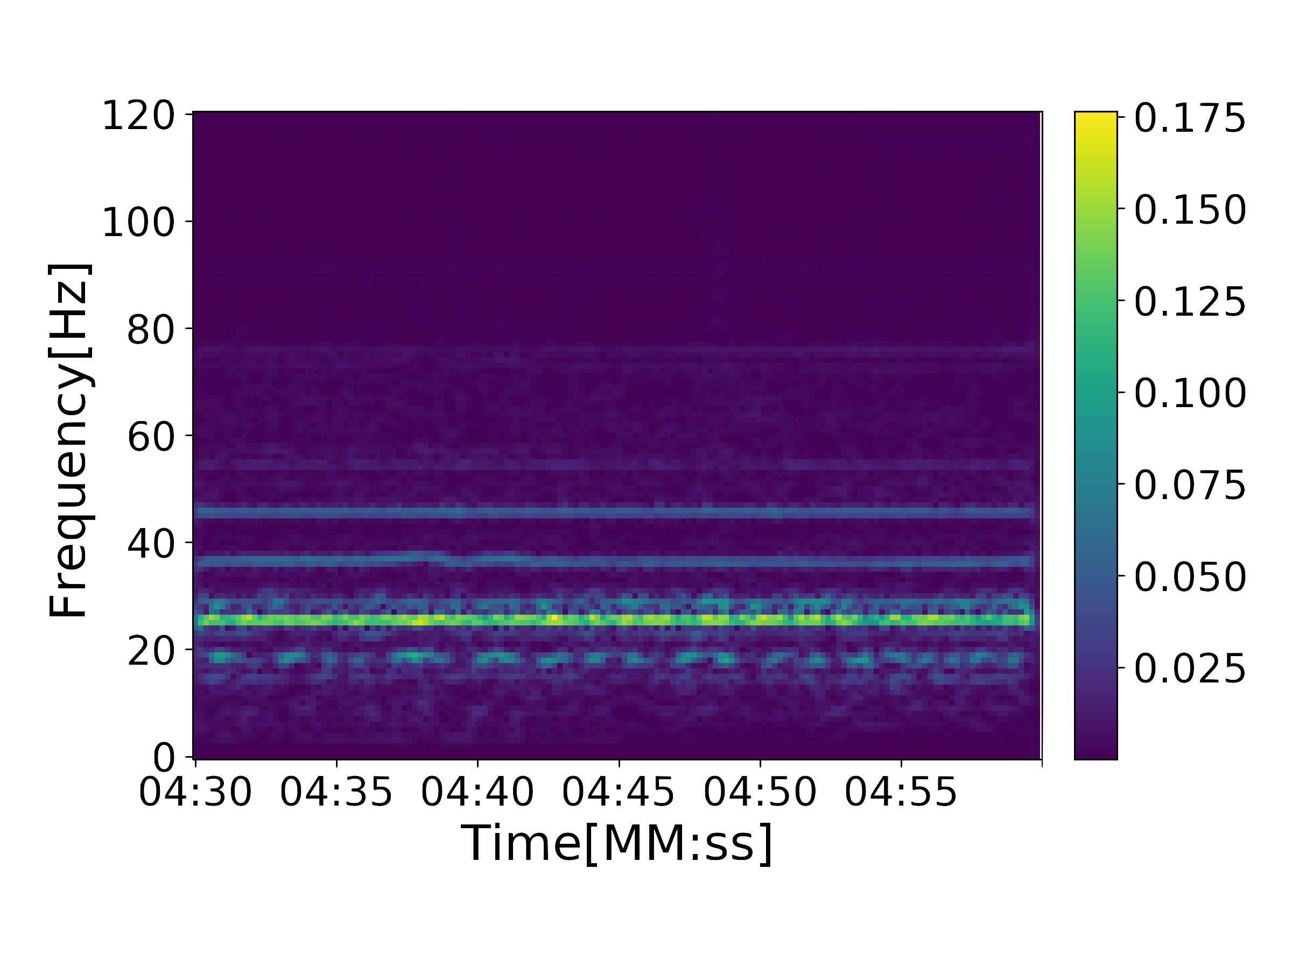
Vibroseis
Pumpjack
Machinery
Notes:
Slide 6:
-Results : apply our machine learning model to the test data.
-model generates classifications of every spectrogram in the test data set and we keep track of the time and station where the signal was recorded
-We generate a timelapse that shows how the label classification changes through time
allows us to identify groups o stations where label classification is constant through time, reflecting local energy
-Here we show 3 examples of noise we were able to identify.
-Start with the bottom:
red stations- area of industrial and manufacturing activity.
Strong hum at 2 Hz with overtones at 38 and 45 Hz
Based on the sepectrograms: rotating machines.
Possibly from a large metal fabrications machine shop in the area.
Black stations:
located in an area of oil and gas operations.
frequency modulated singal that oscillates between 28 and 38 hz with a period of 5 seconds.
related to pump jacks used in the oil and gas extracton process.
-Finally we get to the top spectrogram. I chose to talk about this one last cause it harder to explain.
-group of vibroseismic trucks part of source seismic survey.
The signal : linear frequency modulated chirp- for 40 seconds.
spectrogram shows first 10 seconds starting at ~11);04:50
Our model detects this signal, but classifies as different labels as the signal spans different frequency bins.
here at 11:04:54 the signal is assigned to class label 1. B

Slide 7
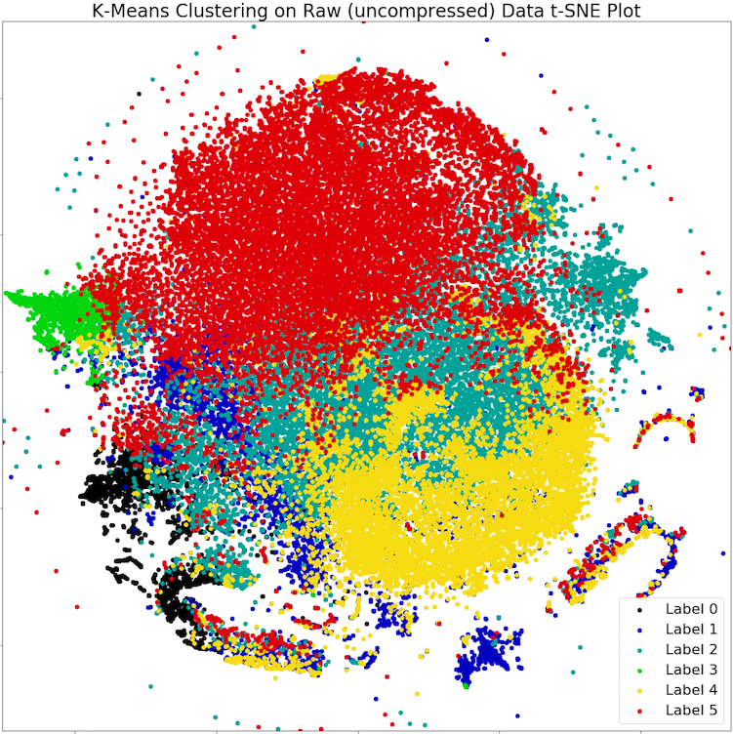
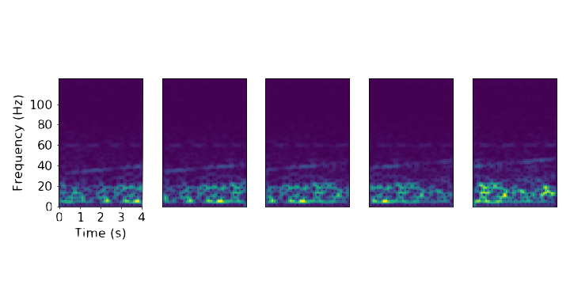
Approach:
Cast differentiating noise signals as a clustering problem.
Unsupervised / Self-Supervised
Problem:
Curse of dimensionality – Spectrograms contain 5,166 features
Computationally expensive
Ineffective
t-SNE Data Distribution; K-means Labels
Notes:
Approach: Now we’ll talk about the problem of classifying spectrograms of cultural noise.
No Labels – need to use unsupervised machine learning or in some cases “self supervised” machine learning
Cast problem as a clustering problem
The problem: dimensionality.
Spectrogram 5,166 spectral amplitude fatures.
In order perform clustering on a gray scale image of shape [126, 41,1] wed have to flatten the image to a 5,166 dimension vector.

Slide 8
Methods
Convolutional Autoencoder (CAE)
Extract features and reduce dimensions of input spectrograms
Learn to extract only the most salient features from input
Produces lower dimensional latent space that can be used to cluster more effectively
Deep Embedded Clustering (DEC)
Probabilistic clustering model that assigns class labels to latent data
uses CAE as a backbone
Initialize cluster centroids with k-means
Iteratively update cluster centroids & model parameters to increase separability between found classes.
Notes:
Methods:
To mitigate the curse:
Feature extraction and dimenstion reduction using CAE
CAE learns to extract most important features from spects
Generates latent data in lower dimensions that is a good representation of original input
These latent samples wouold be the data that is actually classified using a method called DEEP EMBEDDED CLUSTERING
Probabilistic approach to labeling data
Uses CAE as a backbone
Initialized using k-means clustering on the latent data
Improves cluster centroid locations and latent sample classifications.

Slide 9
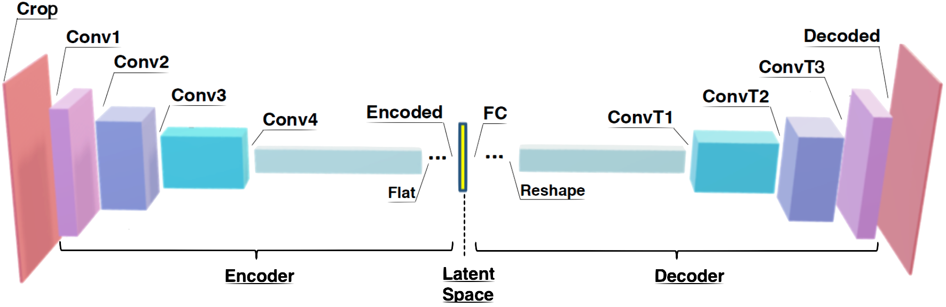
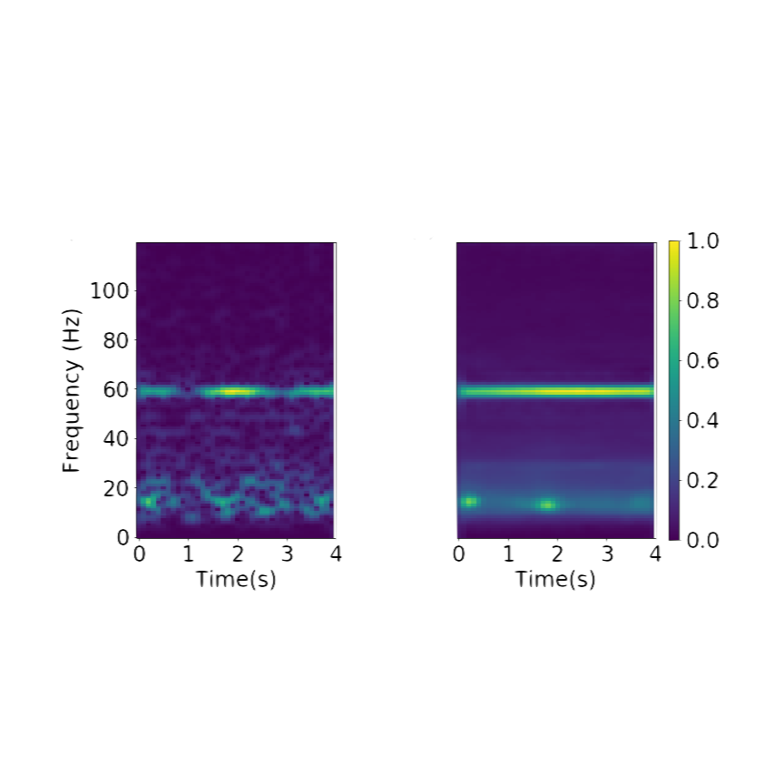
Convolutional Autoencoders (CAE):
Self-supervised machine learning method
Autoencoders: compress images and reconstruct them based on encoded image representation (i.e. Latent space)
Strided convolutional operation preserves local structure of input image during feature extraction and dimension reduction.
Input
Reconstruction
Notes:
CAE Slide:
Autoencoding: basic concept
Convolutional operation: local structure preservation for noisy data
Encoder/decoder
Our encoder: 4 conv layers, fc NN
each conv layer, filter applied, slides along image – dot product -> feature extraction.
-stride of 2 to reduce dimensions by 75 %
-output of 4th conv layer – 7,2,64 -> FC maps to 14 feaatuure latent space
Decoder reverses operations and reconstructs and image w sae dimensions as the input
Note: the filters that are initially applied to the image have randomized weights
-these weights are the parameters we are gaping to train
To train we pass input in batches, calculate MSE== loss function
loss function backpropogted through the network
identify sources of loss I.E. filter weights in both the encoder decoder
weights are updated in a way that lowers the MSE
as model trains and the loss function is minimized the encoder is learning to extract the features that best represent the input spect.
When we talk about well trained CAE we are talking about not only reconst. But also the features present in the latent space being best possible representation of in the input.

Slide 10
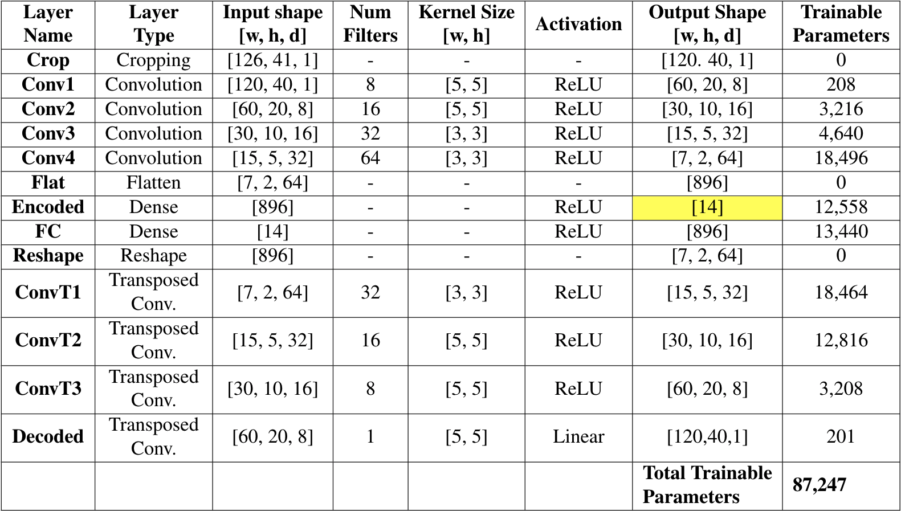
CAE Architecture:
Encoder:
Extracts features and
reduces dimensions of
input spectrograms down
to the latent space.
Latent Space:
Compressed spectrogram
represented by 14 features
(i.e. 14 dimensional vector)
Decoder:
Reconstructs the image from the features present in the latent space
Notes:
DEC Arch Mod Slide:
As previously mentioned the DEC model uses CAE architecture as a backbrone. The encoder and the decoder are exactly the same as the CAE arch, but we are going to add in a clustering layer after the encoder that will operate in paralallel to the decoder
purpose of clustering layer:
maximize the seperability between clusters and increases the density of data assigned to each cluster.
This is done by updating both the encoder weights as well as the cluster centroid locations

Slide 11
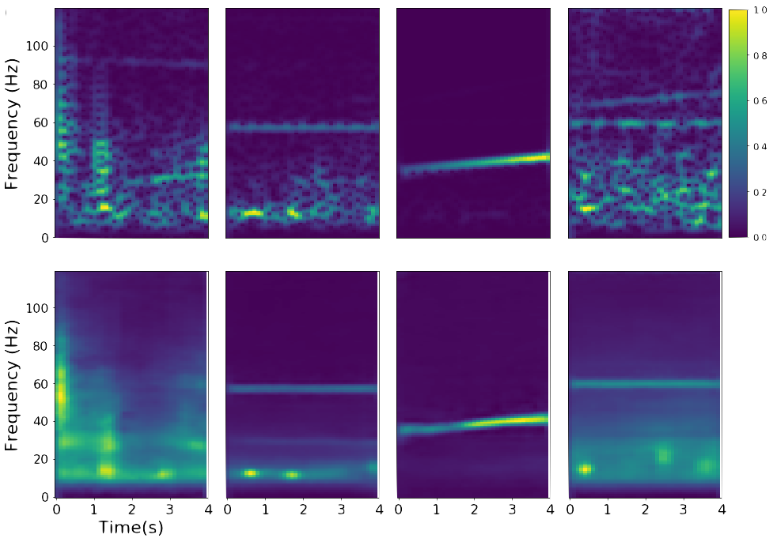
CAE Training Performance:
Originals
Reconstructions
Notes:
DEC Training:
DEC Produces reconstruction and labels of class assignement for each spectrogram
During training: DEC model uses a weighted sum of the:
clustering loss produced by clustering layer and
reconstruction loss produced by decoder T
This reconstruction loss is the same MSE between input and reconstruction as CAE

Slide 12
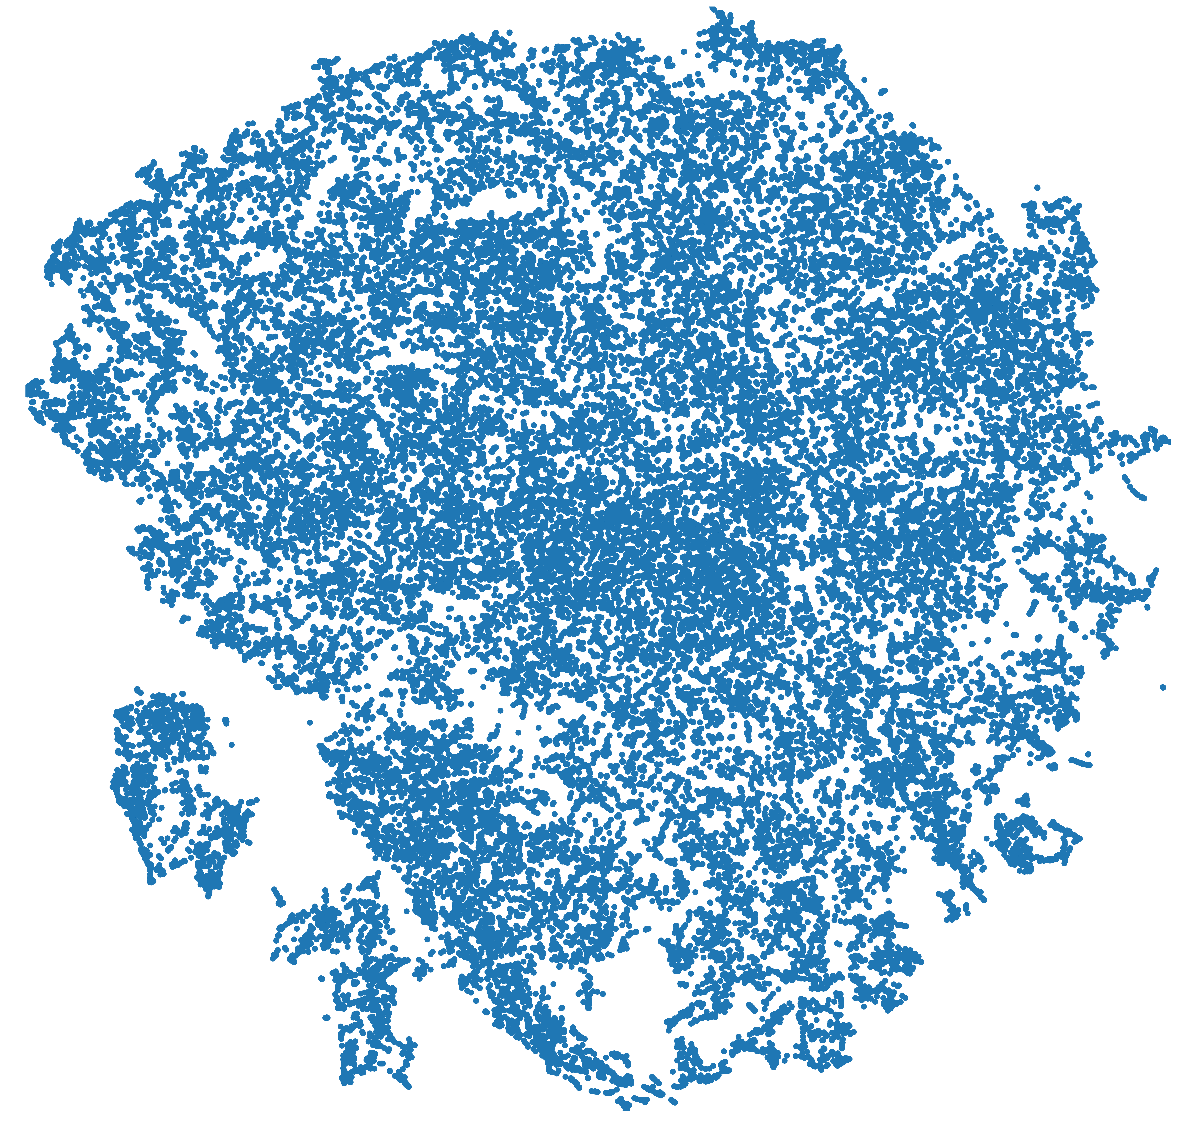
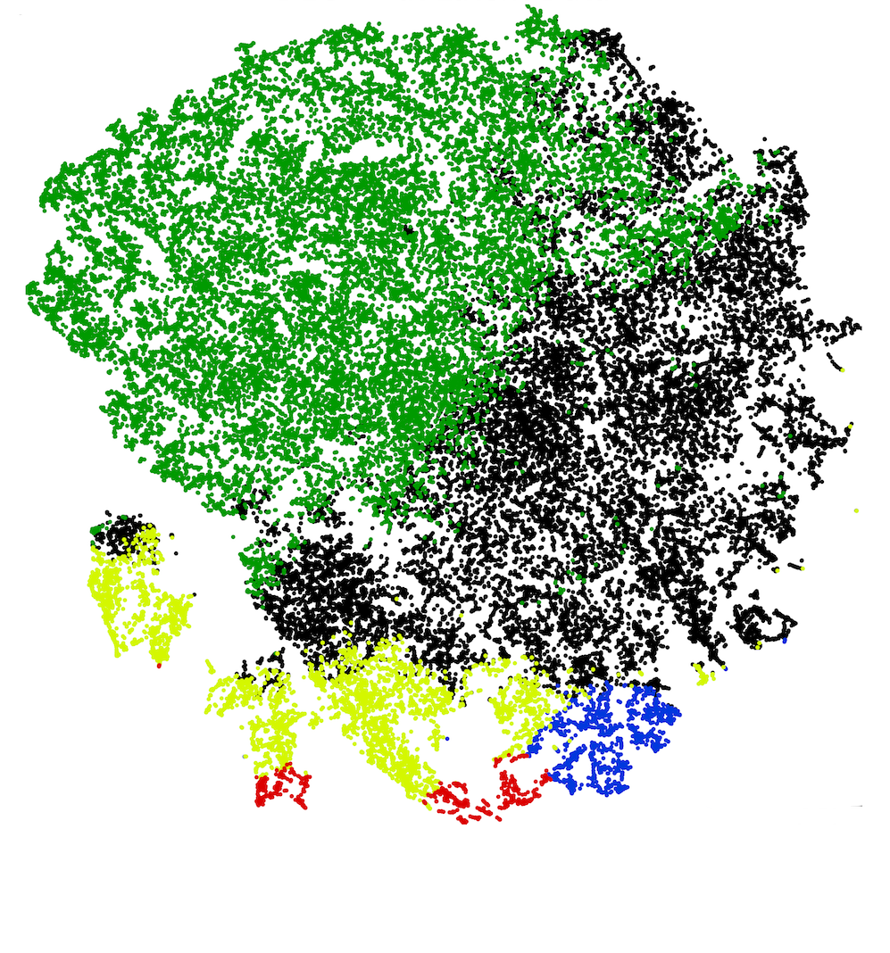
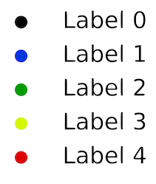
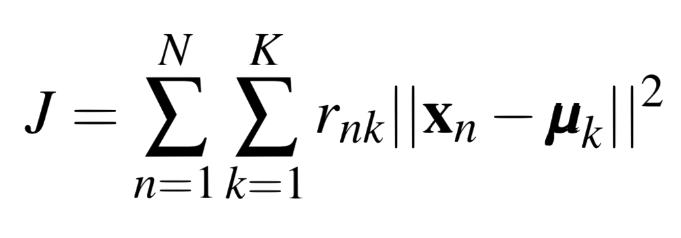
Initialize Cluster Centroids:
Latent Data Distribution
Encode all training data
Perform clustering on latent space data
Initial cluster centroids are calculated using K-Means algorithm:
Take N=1,600,000 observations of D=14 dimensional latent samples and calculate K=5 clusters. (optimal K estimated from data)
K-means seeks to find cluster centroids that minimize the sum-of-squares distance metric:
Cluster Centroids used to initialize DEC model
K-means Cluster assignments
Notes:
Talk about acutal algorithm? Initializations??
Include Distributuions?

Slide 13
Deep Embedded Clustering: Architecture Modification
Incorporate clustering layer that receives a copy of latent data in parallel with decoder.
Clustering layer predicts class label for each latent samples and improves K-means cluster centroids
Increases separability between clusters & density within each cluster
Contributes clustering loss to the total loss function used to train DEC
Notes:
DEC Arch Mod Slide:
As previously mentioned the DEC model uses CAE architecture as a backbrone. The encoder and the decoder are exactly the same as the CAE arch, but we are going to add in a clustering layer after the encoder that will operate in paralallel to the decoder
purpose of clustering layer:
maximize the seperability between clusters and increases the density of data assigned to each cluster.
This is done by updating both the encoder weights as well as the cluster centroid locations

Slide 14
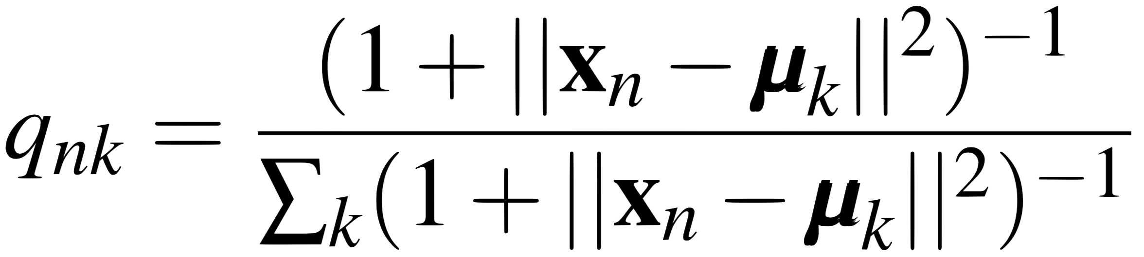
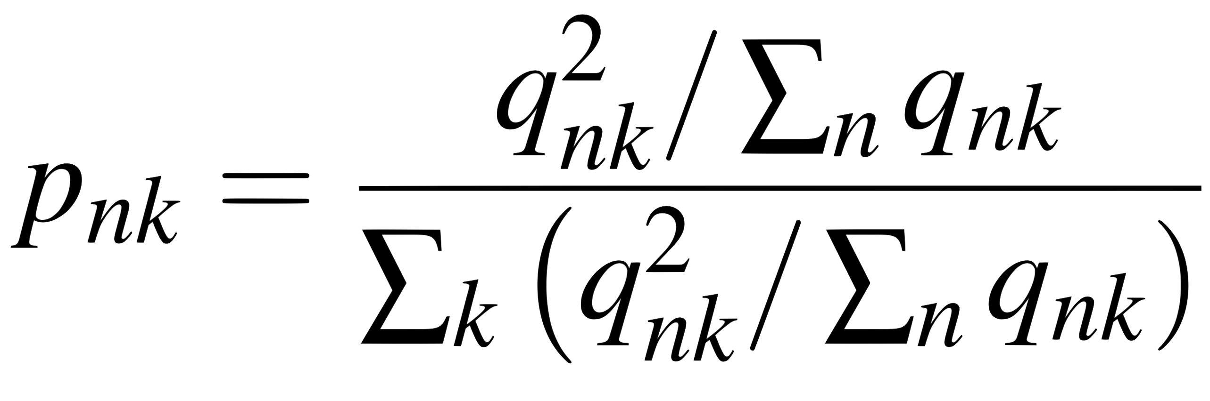
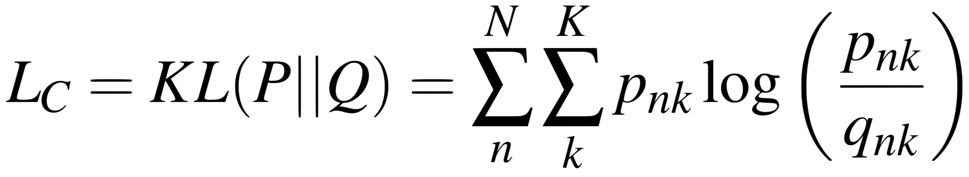
Clustering Layer:
Calculate two probability distributions based on latent space samples and cluster centroids:
Soft assignment probability (q):
Probability that latent sample x_{n} will be assigned to cluster centroid μ_{κ}
2. Target distribution (p):
Student’s t-distribution centered at cluster centroid
Represents distributions where all samples are high confidence assignments
Clustering Loss:
KL-Divergence between soft assignment distribution and target distribution.
Notes:
Clustering Layer Slide:
When the clustering layer receives the latent space data, 2 probability distributions
Soft assignment probability is the probability that a latent sample X will be assigned to a cluster centered around Mu
The soft assignmenst are used to calc a target distribution which is the optimal situation in which all samples assigned to a cluster are high confidence samples.
Distribution is based on students t-distribution. Ideally the target distribtution would be a delta function at the cluster centroid, but studys have show that a t dostrbution is more robust.
The clustering layer uses the difference between these two distribtuions, measured by KL divergence, as a loss function.
During training the clustering layer updates the encoder weights and cluster centroid locations in a way that the kl divergence is minimized
In doing so, centroids are pushed further away from one another, and the features in the latent space are updated so that samples are more densely distributed around centroid.

Slide 15
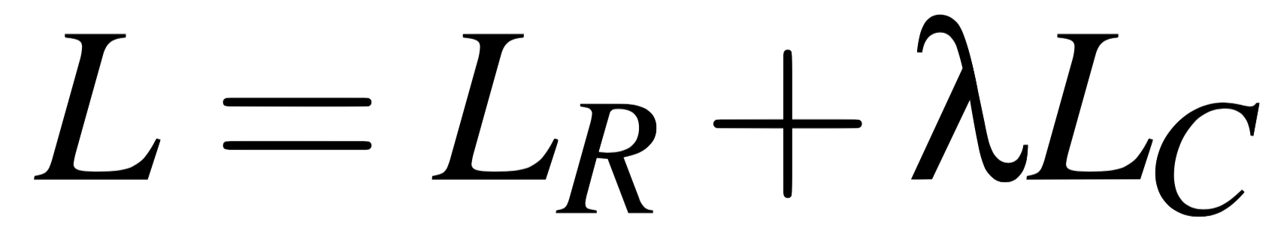
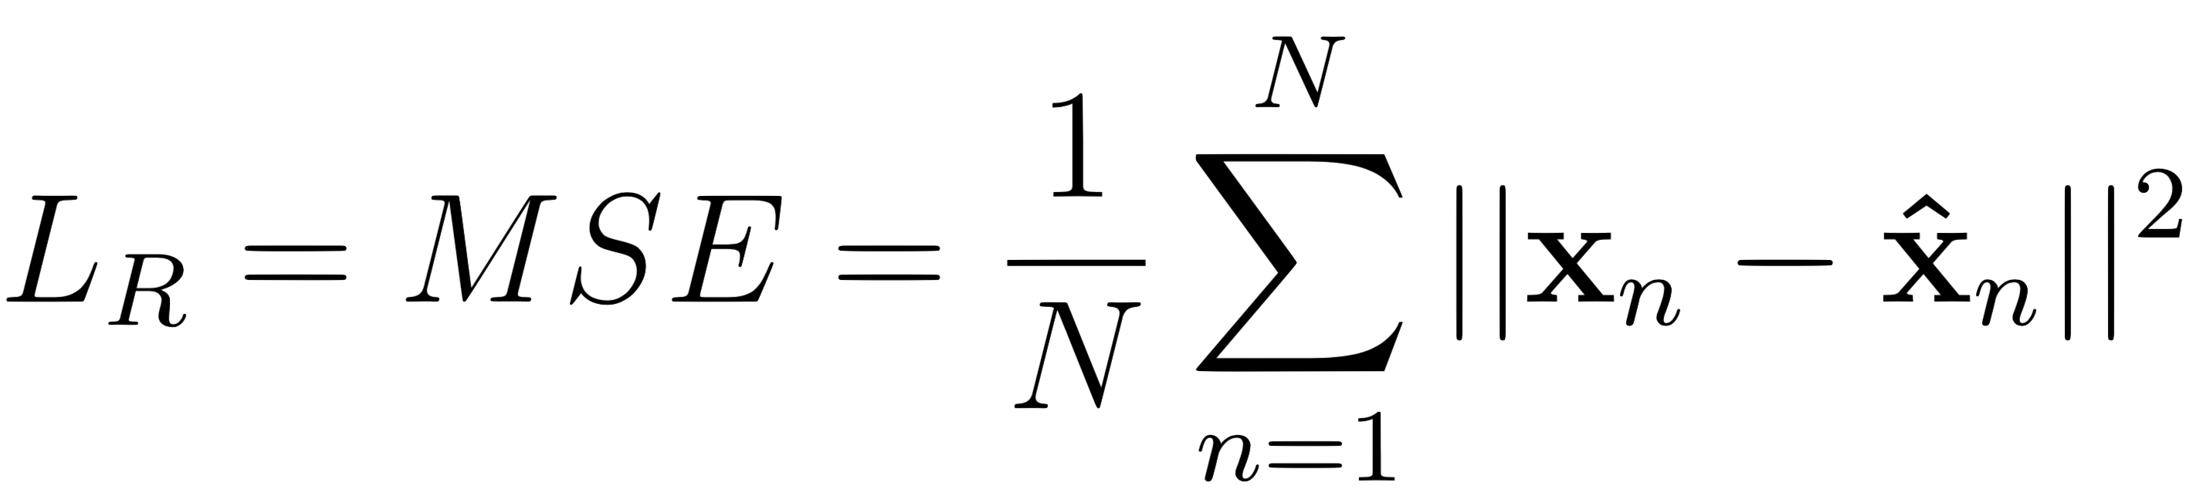
DEC Training
Output of DEC:
Reconstructed spectrograms
Label classification
DEC training loss function (L) is weighted sum of reconstruction loss (L_{R}) and clustering loss (L_{c})
*same as CAE training
Notes:
DEC Training:
DEC Produces reconstruction and labels of class assignement for each spectrogram
During training: DEC model uses a weighted sum of the:
clustering loss produced by clustering layer and
reconstruction loss produced by decoder T
This reconstruction loss is the same MSE between input and reconstruction as CAE

Slide 16
DEC Training:
Total loss function limits the amount of of influence of clustering loss
λ - regularization term (λ = 0.11)
λ too high leads to distorted latent space & trivial solutions
L_{R} is backpropagated through network to update encoder & decoder weights
L_{C} is backpropagated through network to update encoder weights and cluster centroids
Iterative training
Update p, q, 10times/epoch
Notes:
DEC Training 2: TOTAL LOSS
The lambda term: applied to clustering losss
Limits influence of clustering loss over DEC model training
If we allow the clustering loss too much influence over model training
Often get trivial solution where the latent space is distorted
All latent samples are assigned to a single cluster and all other centroids are pushed far way that cluster,
The reconstruction loss is back propogated through array and identifies encoder decoder wiehgts needing to be updated
Clustering loss backprogoated to identify encoder wiehgts and cluster centroids needing to be updated
DEC trains by updating the model parameters to decrease the TOTAL losss function
Iteratively update encoder wiehgts, decoder, weight, and recalculated the propabilities in the clustering layer 1x/epoch over a total of 50 epochs
DEC trains by updating the model parameters to decrease the TOTAL losss function

Slide 17
DEC Performance:
Apply DEC model to unseen test data.
3 methods to visually inspect clustering performance:
Inspect spectrograms assigned to each cluster at specific time instances.
Timelapse Video
T-SNE – data distribution
Notes:
DEC Performance Slide:
Once the DEC model has been trained we apply the model to the unseen test data
Remember that the test data is generated from March 6th between 11:00 and 11;!0 UTC during vibroseismic activity
3 methods:
Visual inspectrion of the spectrograms assigned to each cluster at specific time instances
The timelapse video that we saw earlier
T-SNE data dsitributions
Seen several times, but were going to spend a little more time discussing the data distributions

Slide 18
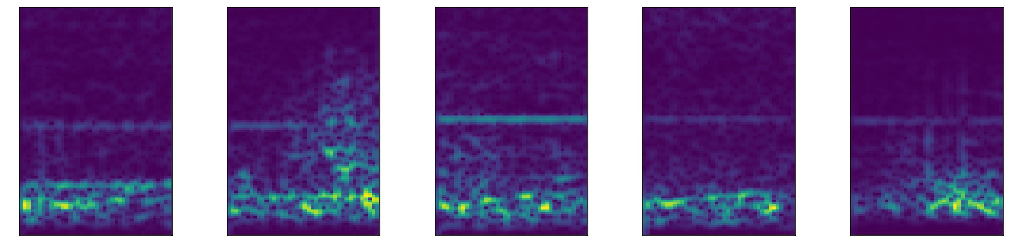
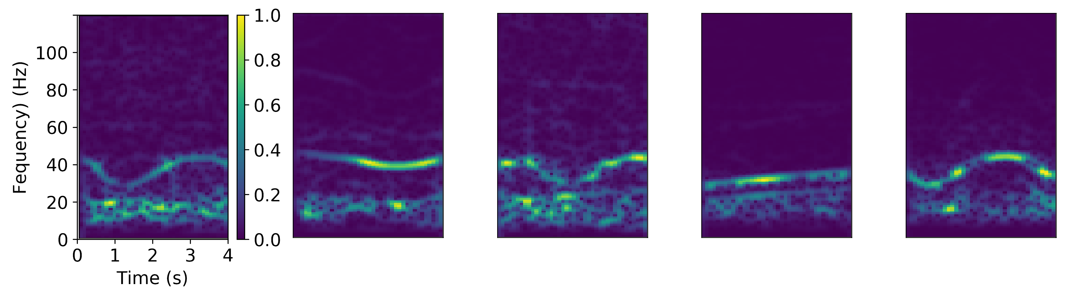
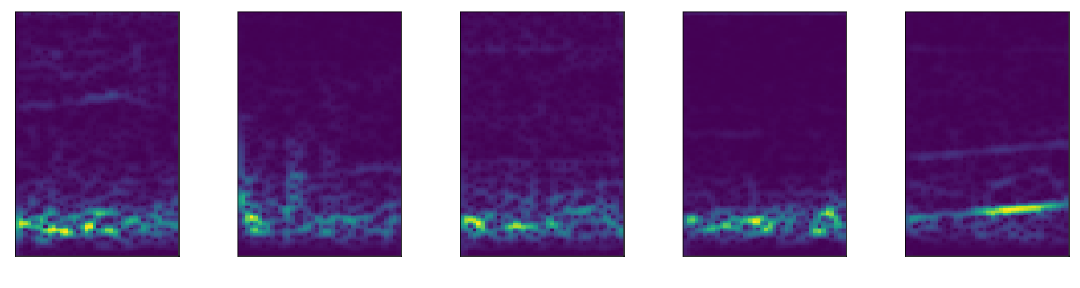
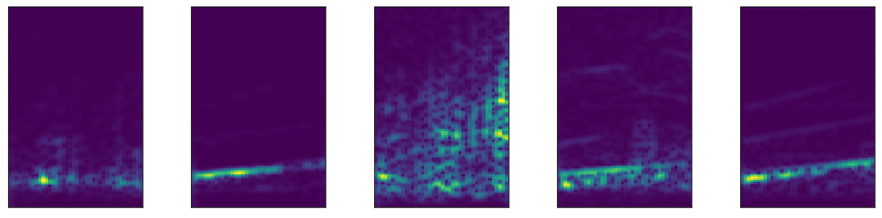
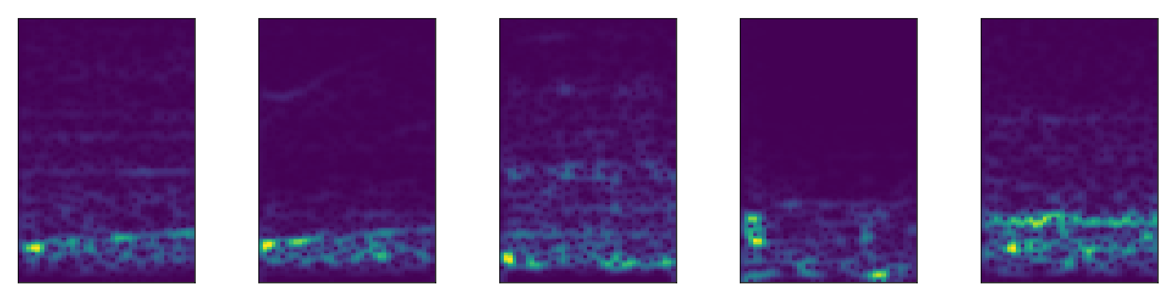
Cluster Assignments:
Label 2:
Label 0:
Label 3:
Label 1:
Label 4:
Notes:
Visual Inspection Slide:
THe simplest way of estimating how well our model performs is to look at specific time instances of the test data and look at the spectrograms in each cluster
Here we show 5 examples from each cluster at 11:00:24 seconds
Label zero: most similar signals:
similar pumpjacks
freqquncy modulated and oscilates between 25-40 Hz
label 1 Maybe: vibroseismic sweep
linear frequency modulared singal ~20hz -30hz
Label 2 : energy at 5-20 hz with a
faint hum-like at 60Hz
like lyfrom electrical lines
Label 3:
energy again around 5-20 hz
misclassified as it appears to be a virbosiesmic sweep
Label 4 is similar to label 3

Slide 19
Timelapse
Shows the DEC label assignment of each station’s spectrogram every 1 second between 11:00:00-11:10:00 UTC.
Key in identifying areas of local energy (consistent labels).
Observe propagation of energy through array.
Notes:
TImelapse:
We will revist the timelapse video to show you the full 10 minutes of test data
Again this is a key method in identifying areas with local energy
Seeing how the labels change through time
label classification for the vibroseismic signals change
lFM singal spans differente freqs
Vibrseis signal last about 40 seconds
Increases frequency between 10-80 Hz
Label changes in predictive manner
The black group of stations:
O&G territory
Constant through time
Red stations is the area of manufacturing/industry
Constant hum at several frequencies
Rotating machinery

Slide 20
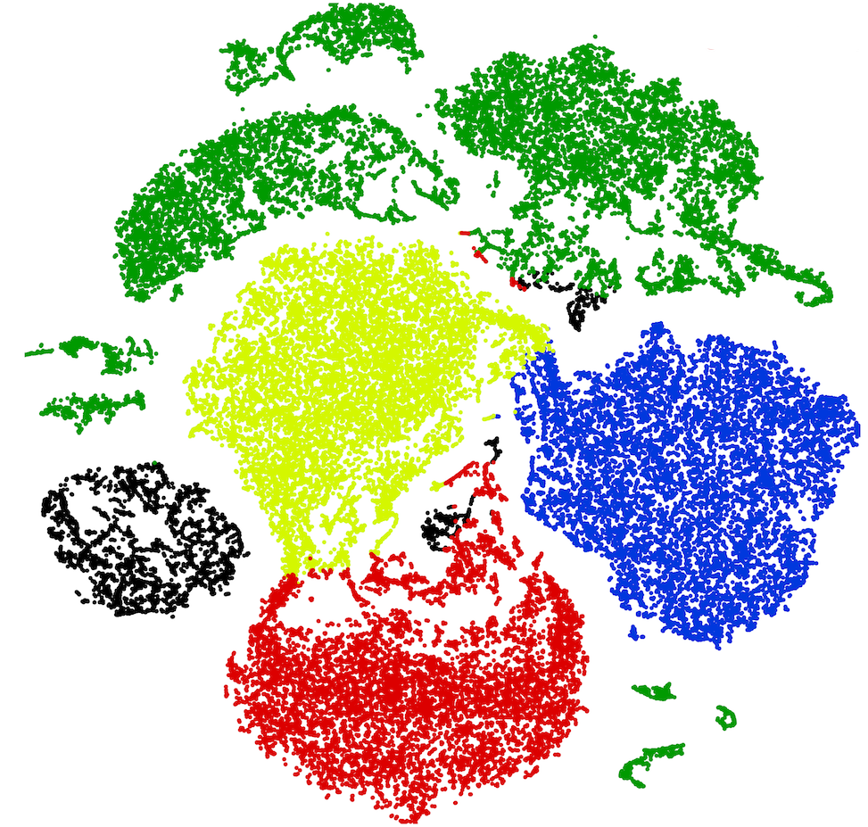
t-SNE Data Visualization
DEC model improved separability between clusters and increased density within each cluster
T-distributed Stochastic Neighbor Embedding
Highly non-linear transformation
14 dimensions -> 2 dimensions
DEC Output
DEC Input with K-means Cluster assignments
Notes:
t-SNE:
Last method of analyzing performance is through t-SNE plots
Non linear transform that maps data from high dimensions to 2 dimensions
Data visualization tool
can be helpful to understand the structure of the data
Often shows non-reaistic structures as a consequence transformation
Here we do not make any attempt at interpreting the spatial physics of the distribution
Mostly for comparison of DEC input and DEC output
Majority of samples in large blob – resembles gaussian normal dist.
Some smaller groups of data that may be clusters but assigned to several labels by kmeans
(more on this in a moment)
After DEC
Clusters can be seen
Well separated
Higher density
Some outliers but most well assigned
DEC model has been effective at separating classes
Label 2 in the top is the worst cluster in its appearance
Has several separated groups with same label
May indicate that more clusters may exist in the data
This brings us to one issue with Kmeans clustering – effect DEC
Kmeans algorithm makes two assuptions as it assigned samples to clusters
Clusters have equal variance
Similar sizes

Slide 21
Conclusion:
CAE is promising method of feature extraction and dimension reduction
DEC model able to detect and separate strong signals with distinct characteristics
Pump jacks
Rotating machinery
Vibroseismic sweeps
Some data does not meet this criteria
Future work make include different clustering algorithms
Not as reliant on K-means

